Slide 1
Docker
-
Prabhakar

Slide 2
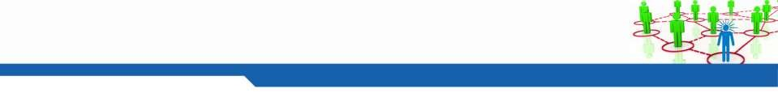
2
Agenda
▪
▪
▪
What is Docker
Container Vs Virtual machine
Docker Platform components
▪
▪
▪
▪
▪
▪
Docker Engine
Images
Containers
Registry
Repositories
Docker Hub
▪
Demo

Slide 3


Container History
1979 - Chroot
• Unix system call to change the root of a process and sub process, added to
BSD in 1982
• Used to provide isolated disk space for process
2004 – Solaris Containers (Zone)
• Combination of system resource controls and the boundary separation
provided by zones
• Zones act as completely isolated virtual servers within a single operating system instance
2006 – Process containers
• Process containers for limiting, accounting, and isolating resource usage (CPU, memory, disk I/O, network, etc.) was added by google to Linux kernel
2007 - Control groups
2008 –LXC
• Process container was renamed to control groups
• Combining control groups and Linux namespace, Linux containers( LXC) was introduced with the API bindings for python, Go, Ruby etc.
2013 – Docker
• Docker started with LXC and later replaced with it’s own library called
libcontainer. Docker introduced an entire ecosystem for managing containers.
• Highly efficient, layered container image model, a global and local container registries, a clean REST API, a CLI, etc. Docker also took an initiative to implement a container cluster management solution called Docker Swarm
2016 – Windows containers
• Windows Container introduced in Windows 10 and windows 2016
• Windows base OS images: Servercore and nanoserver

Slide 4
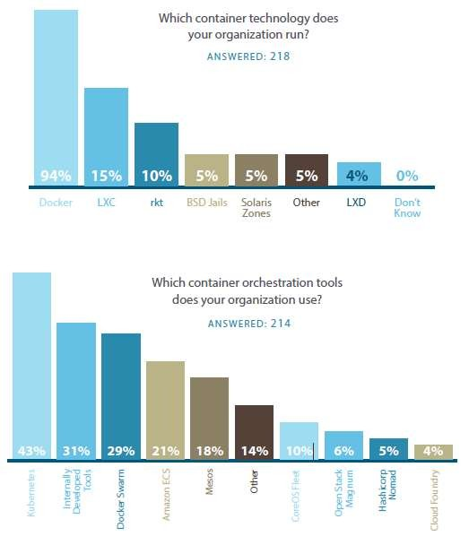
Market Share

Slide 5
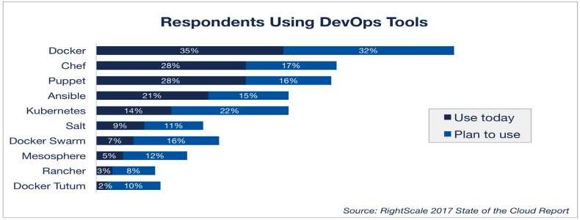
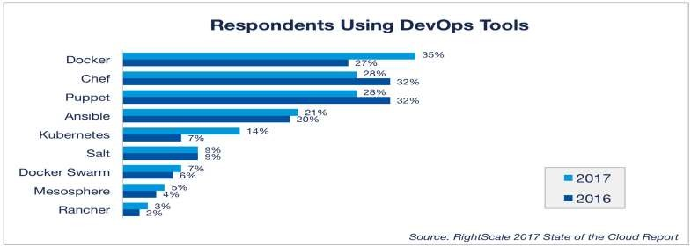
Docker Trends

Slide 6
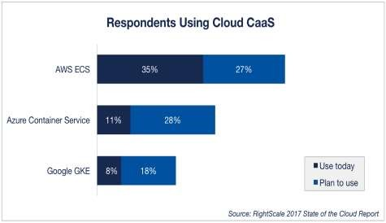
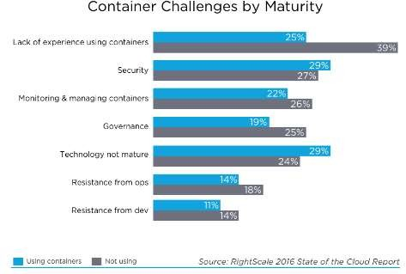
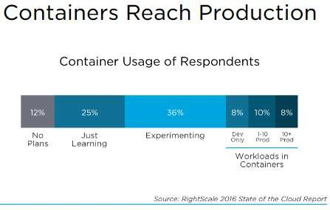
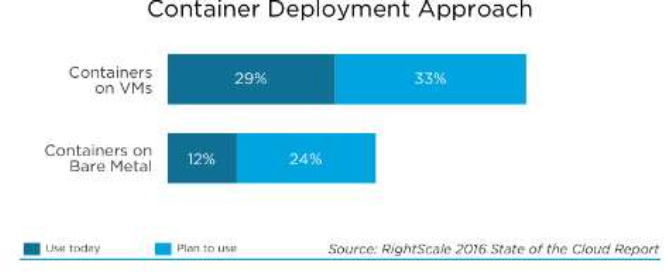

Docker Trends

Slide 7
What is Docker
▪
Docker containers wrap a piece of software in a complete file system that
contains everything needed to run: code, runtime, system tools, system libraries –
anything that can be installed on a server. This guarantees that the software will
always run the same, regardless of its environment.
-- Docker.com
Docker is a tool designed to make it easier to create, deploy, and run applications
by using containers. Containers allow a developer to package up an application
with all of the parts it needs, such as libraries and other dependencies, and ship it
all out as one package. By doing so, the developer can rest assured that the
application will run on any other Linux machine regardless of any customized
settings that machine might have that could differ from the machine used for
writing and testing the code.
– Opensource.com
▪

Slide 8
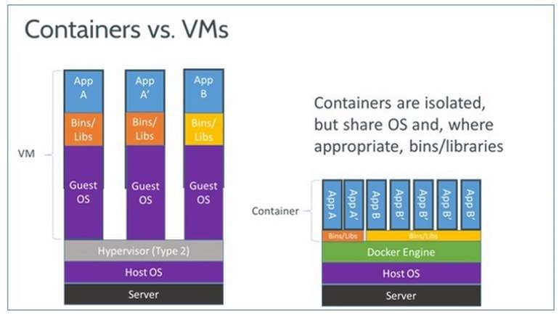
Docker Vs Virtual Machines

Slide 9
Docker Comparison
Machine
Virtual Machine
Container
Slow
Deployment
Multiple VM on the same machine, Easy deployment
Very quick deployment and easy to spin – Like a process
High Cost
Cost shared with multiple Vms
Cost optimized, Light Weight, Many containers on the machine vs VM
Wasted resources
Shared resource - Requires own CPU, RAM, Storage and OS
Shared - Uses kernel on the host to run multiple guest instances
Difficult to
Scale
Simpler to Scale
Easy scaling - No OS required
Less CPU, RAM, Storage
Difficult to
Migrate
Provision to move and upgrade
– snapshots, templates
Simple upgrade, data segregation, less in size to copy, transfer
Vendor Lock in
Conversion tools available
Good Portability

Slide 10
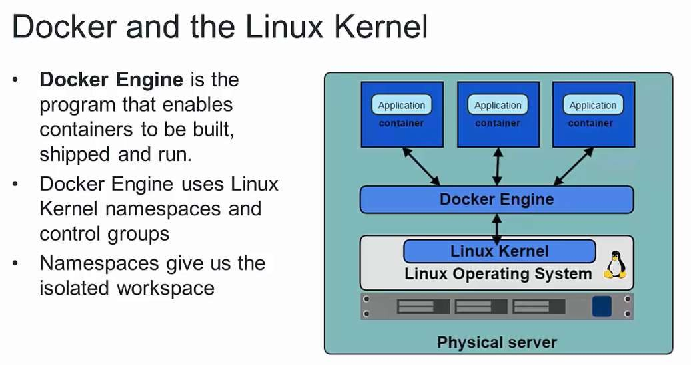
Docker Engine / Docker Daemon

Slide 11
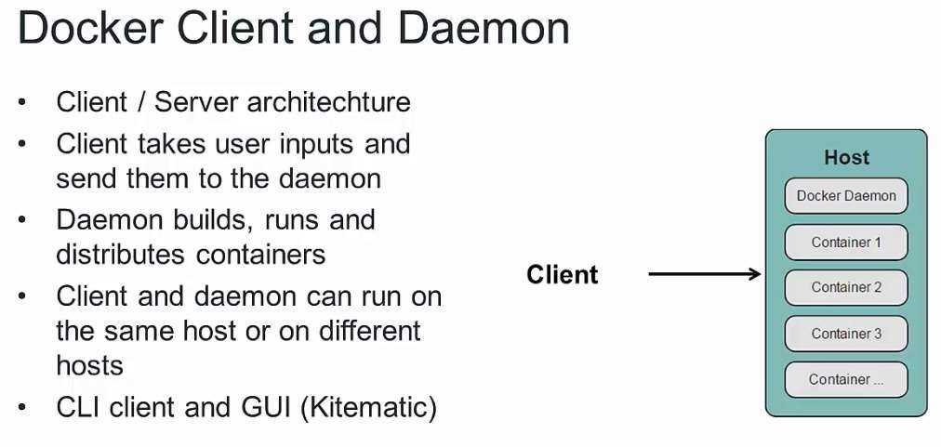
Docker CLI

Slide 12
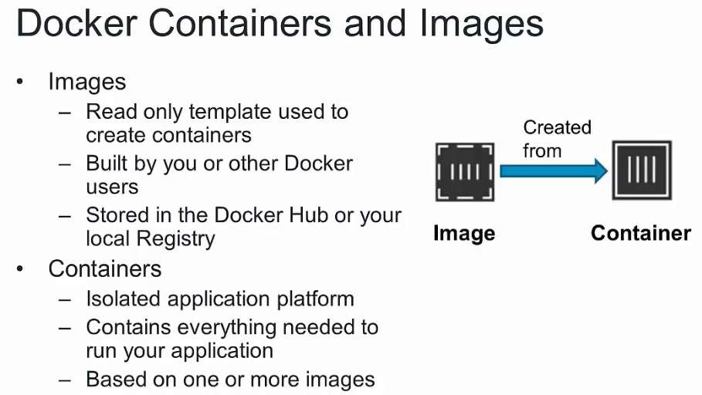
Containers and Images

Slide 13
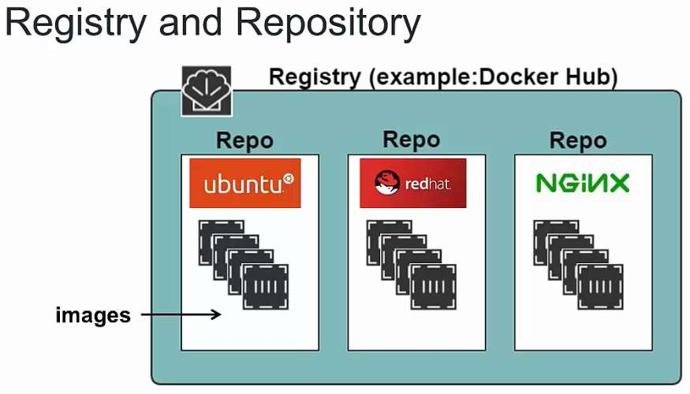
Docker Registry

Slide 14
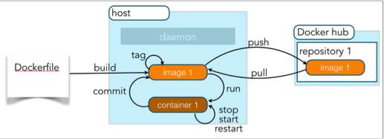
14
Docker Lifecycle

Slide 15
Docker Requirement
▪
Docker
is a
platform
for
Developing,
Shipping
and
running
applications using container virtualization
Need a Linux machine ( Either physical machine / Virtual machine)
Linux command line familiarity
Windows version is getting released
▪
▪
▪

Slide 16
Docker
▪
Container has
▪
▪
▪
▪
▪
Root filesystem
Process
Memory
Devices
Network stack
▪
Multiple application
in the same machine
▪
Avoiding conflict when sharing the common tools
▪ JVM 7
▪ JVM 8
▪
Sharing the resources

Slide 17
Installing Docker – Redhat / Centos
▪
▪
Requires 64-bit OS and Linux
Install with YUM
kernel 3.10+
$ sudo tee /etc/yum.repos.d/docker.repo <<-'EOF' [dockerrepo]
name=Docker Repository baseurl=https://yum.dockerproject.org/repo/main/cen tos/7/
enabled=1 gpgcheck=1 gpgkey=https://yum.dockerproject.org/gpg EOF
▪
▪
Add Docker repo to YUM
yum install docker-engine
▪
Install using script
$ curl -fsSL https://get.docker.com/ | sh
Enable and start the service
$ sudo systemctl enable docker.service
$ sudo systemctl start docker
▪

Slide 18
Installing Docker – Contd..
▪
Test the installation
$ sudo docker run hello-world
Add users to Docker group to grand
$ usermod –aG docker <user>
Docker version
$ docker version
Docker system information
$ docker info
▪
privileges
▪
▪

Slide 19
Docker Images
▪
▪
▪
Stored in registry under different repositories
Several images are present in the Docker hub
Public registry is “Docker hub” – hub.docker.com new place is
docker store store.docker.com
Docker registry account is free, No credit card required
▪

Slide 20
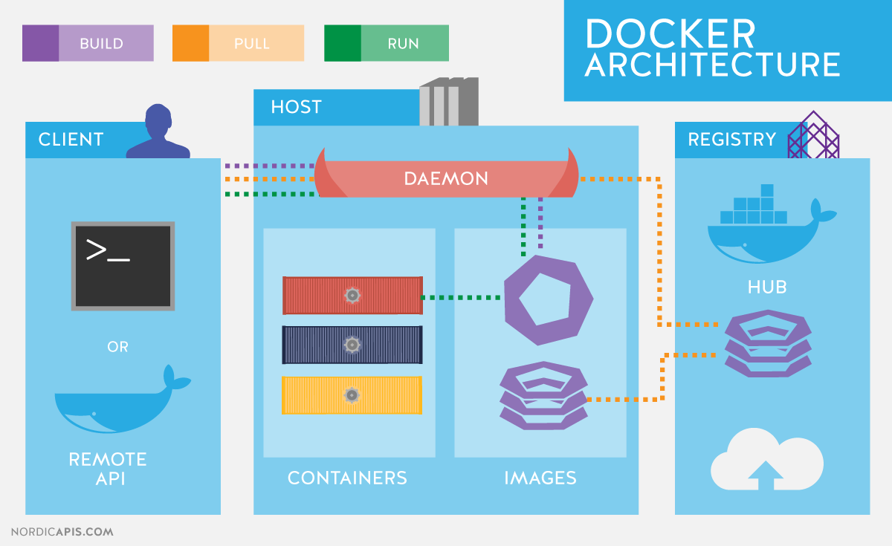
Architecture

Slide 21
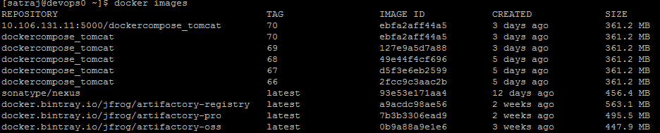
Images
▪
▪
Docker stores the images locally
When a creating the container, Local images are used by the
Docker Engine
If not found, image is downloaded from the DockerHub ( Slow) Display the available Docker images list by
▪
▪
▪
$ Docker images

Slide 22
Images Contd…
▪
Docker image
▪
▪
▪
Repository Name
Has a version / tag
Image ID
▪
Images are represented
by
▪
▪
▪
“Repositoryname:Tag”
Tag Latest is used if not specified
Tags represent the version / specific named image

Slide 23
Container
▪
Start the container by
$
$
▪
docker run tomcat
docker run centos ps eaf
Syntax “docker run [options] image [command] [args] ”
▪
Start the container with the terminal, every start
container
creates
new
▪
▪
$ docker run –it centos /bin/bash
Places the user inside the container shell
▪ -i represents standard input
▪ -t allocates pseudo-terminal

Slide 24
Container Operations
▪
Add a user inside the container
$ adduser devops
$ cat /etc/passwd
Use the characters “CTRL + P + Q” to come out of container
terminal to the main terminal
Container can be represented by container ID / name
▪
▪
▪
▪
“docker ps” lists the running containers
“docker ps –a” Lists all the containers irrespective of the state
▪
Run the containers in detached mode with the –d flag
▪
Docker run –d tomcat

Slide 25
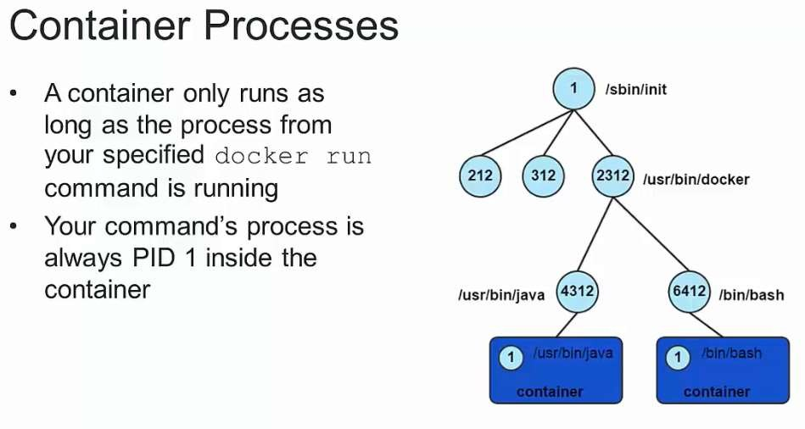
Container Process

Slide 26
Container Operations contd…
▪
Monitor the container standard output/log with
the
command
“logs”
▪
docker logs <container ID / Name>
▪
Expose the ports with the command –P /
-p
▪
▪
docker run –d –P tomcat
docker run –d –p 8080:8080 tomcat
▪
Start and stop the pre existing container
▪
▪
docker start <container ID / Name>
docker stop <container ID / Name>
▪
Save the container as image
▪
▪
docker commit 0e423cb38135 testimage:test
docker commit [OPTIONS] CONTAINER [REPOSITORY[:TAG]]

Slide 27
Container Operations contd…
▪
Attach to the running container
▪
▪
docker exec [OPTIONS] CONTAINER COMMAND
docker exec -it 0e423cb38135 /bin/bash
[ARG...]
▪
Inspect the container details
▪
docker inspect [OPTIONS] CONTAINER|IMAGE|TASK
[CONTAINER|IMAGE|TASK...]
docker inspect 0e423cb38135
▪
▪
Delete an image / container
▪
▪
▪
▪
docker
docker
docker
docker
rm [OPTIONS] CONTAINER
rm determined_meitner
[CONTAINER...]
rmi [OPTIONS] IMAGE [IMAGE...]
rmi testimage:test

Slide 28
Image Operations contd…
▪
Tagging images
▪
▪
docker tag testimage:test testtag:1
docker tag IMAGE[:TAG] IMAGE[:TAG]
▪
Save and load the images
▪
▪
docker save [OPTIONS] IMAGE [IMAGE...]
docker load –i <tarfile>
▪
Push and pull an image to repository
▪
▪
▪
docker tag testtag:1 10.106.131.11:5000/testimage
docker push 10.106.131.11:5000/testimage
docker pull 10.106.131.11:5000/dockercompose_nginx:40

Slide 29
29
Reference
▪
▪
▪
▪
https://www.docker.com/what-docker
https://docs.docker.com/engine/understanding-docker/
https://docs.docker.com/engine/installation/
https://docs.docker.com/engine/userguide/intro/

Slide 30
Thank
You!

